Slide 1
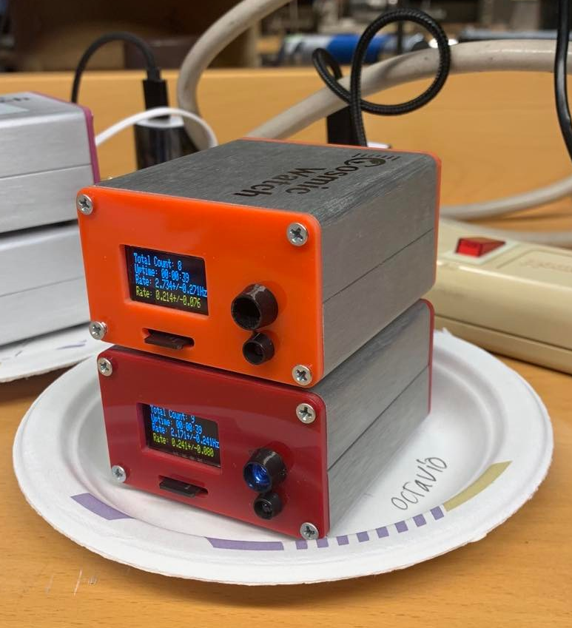
Angular Dependence of Muon Intensity
Octavio Vega and Luke Gianni
8.13 Experimental Physics 1 – Fall 2021

Slide 2
Experimental Goals
Investigate the dependence of muon count rate on angular elevation of the CosmicWatch desktop detectors
Arrive at a quantitative relationship between the count rate and the elevation angle

Slide 3
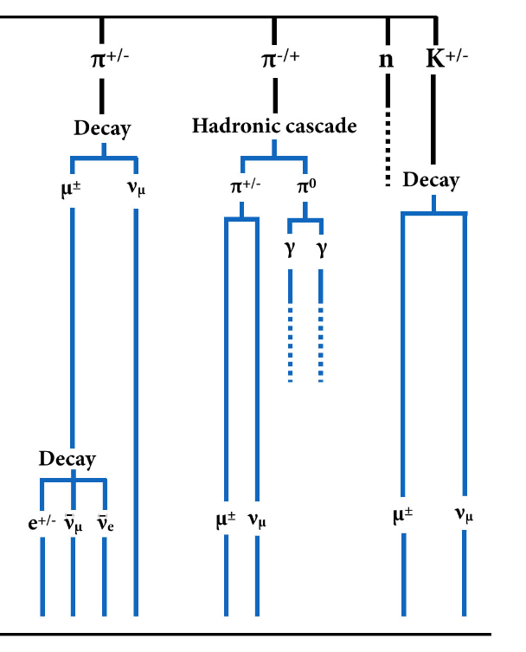
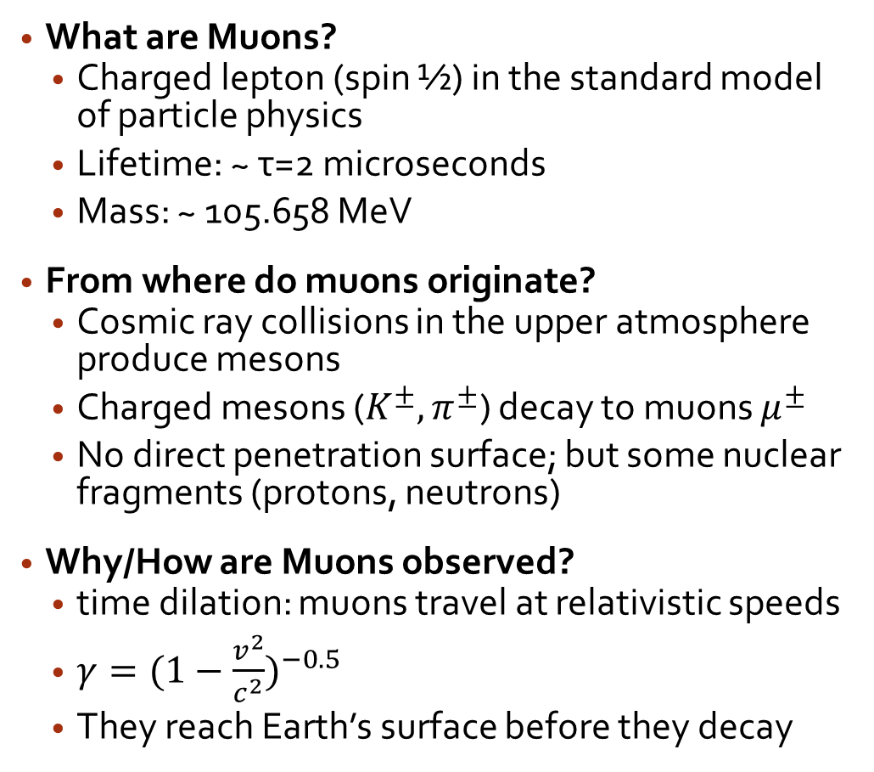
Background Theory on Muons
Cosmic Ray/Nuclear Interaction
What are Muons?
Charged lepton (spin ½) in the standard model of particle physics
Lifetime: ~ τ=2 microseconds
Mass: ~ 105.658 MeV
From where do muons originate?
Cosmic ray collisions in the upper atmosphere produce mesons
Charged mesons ($K^{±}, π^{±}$) decay to muons $μ^{±}$
No direct penetration surface; but some nuclear fragments (protons, neutrons)
Why/How are Muons observed?
time dilation: muons travel at relativistic speeds
$γ={(1−\frac{v^{2}}{c^{2}})}^{−0.5}$
They reach Earth’s surface before they decay
Earth’s Surface
Notes:
Same charge as electron, but about 200 times as massive
Muons are generated when cosmic rays interact with the upper atmosphere of the Earth
We see to the right a diagram I’ve modified depicting a portion of a particle decay shower resulting from a nuclear collision amidst atmospheric cosmic rays
Due to the non-abelian structure of QCD, the theory governing the strong force under which the quarks (constituent particles of the mesons) interact, they decay to a shower of particles called a cascade or parton shower, only some of whose particles are shown.
Namely, we see dimuon pairs being generated from charged meson decays

Slide 4
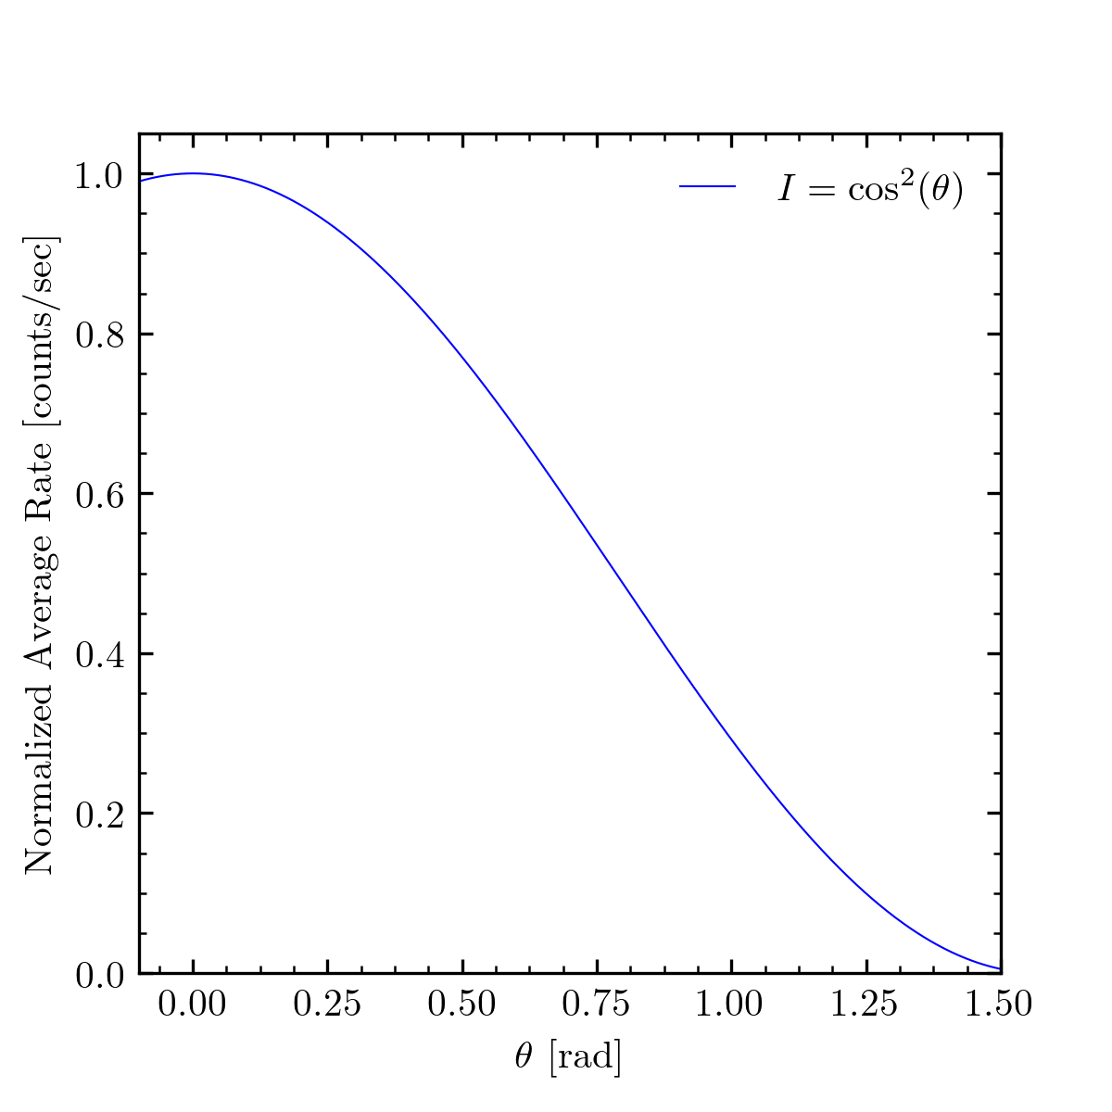
Theoretical Angular Dependence of Count Rate
Notes:
I’ve plotted here a model
The inspiration derived from the particle data group library

Slide 5
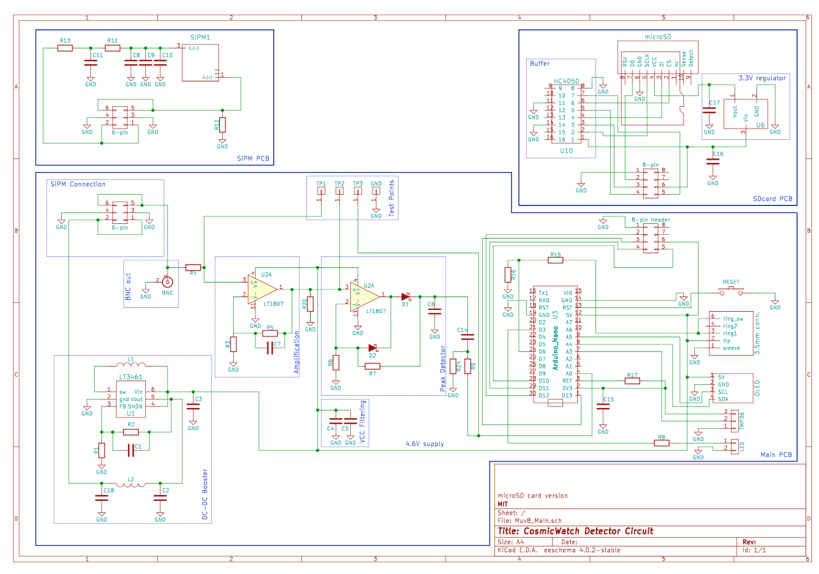
Muon Detector Signal Chain
Muons arrive at the detector
Muons traverse through the scintillator and emit scintillation light
SiPM detects scintillation light and sends signal through the PCB
Microcontroller measures the time and amplitude of the signal
Notes:
Consists of silicon photomultiplier PCB

Slide 6
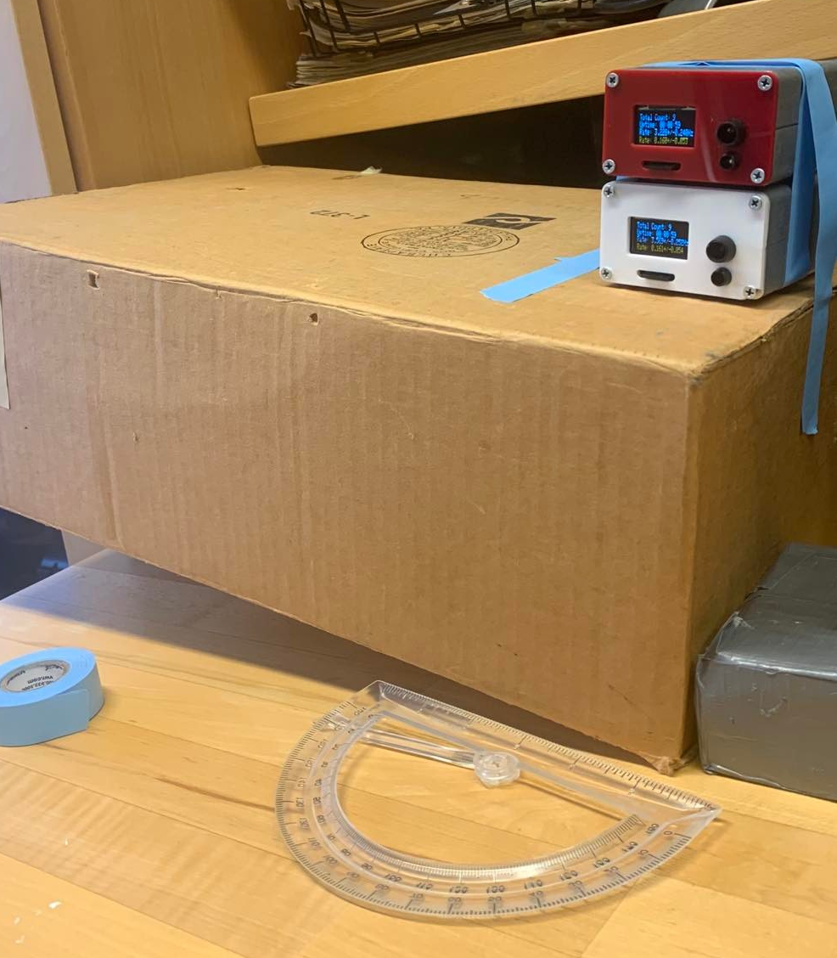
Experiment Apparatus
Securing tape
‘Tsung Dao Lee’
‘Katherine Johnson’
Cosmic Watch detectors
Angled box platform
protractor
θ
Notes:
Theta is the elevation angle that we vary

Slide 7
Data Collecting Procedure
Vary the detector platform’s tilt by angle of 10 degrees (repeat in these increments from 0 t0 60 degrees)
Allow the CosmicWatch detectors to collect data for 12 minute periods for each angle (always in coincident mode)
Examine the total counts and compute average muon count rates for each angle
Fit a squared sinusoidal functional to the observed average count rates vs. angle data

Slide 8
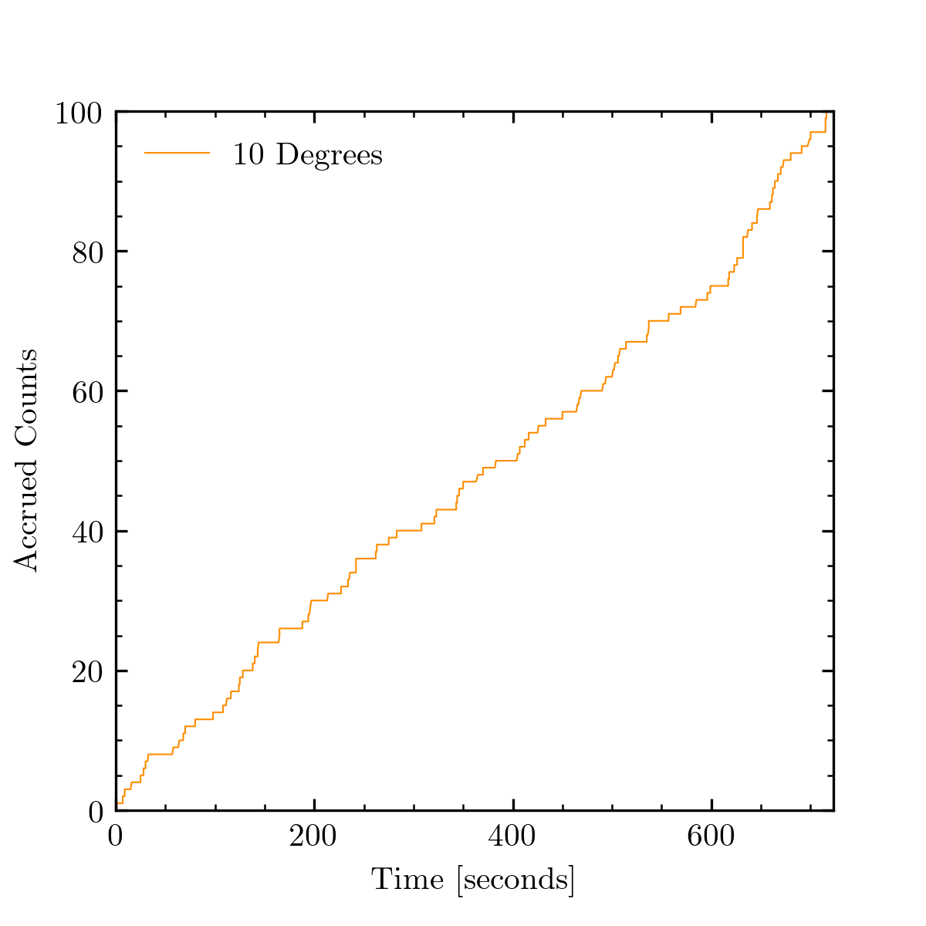
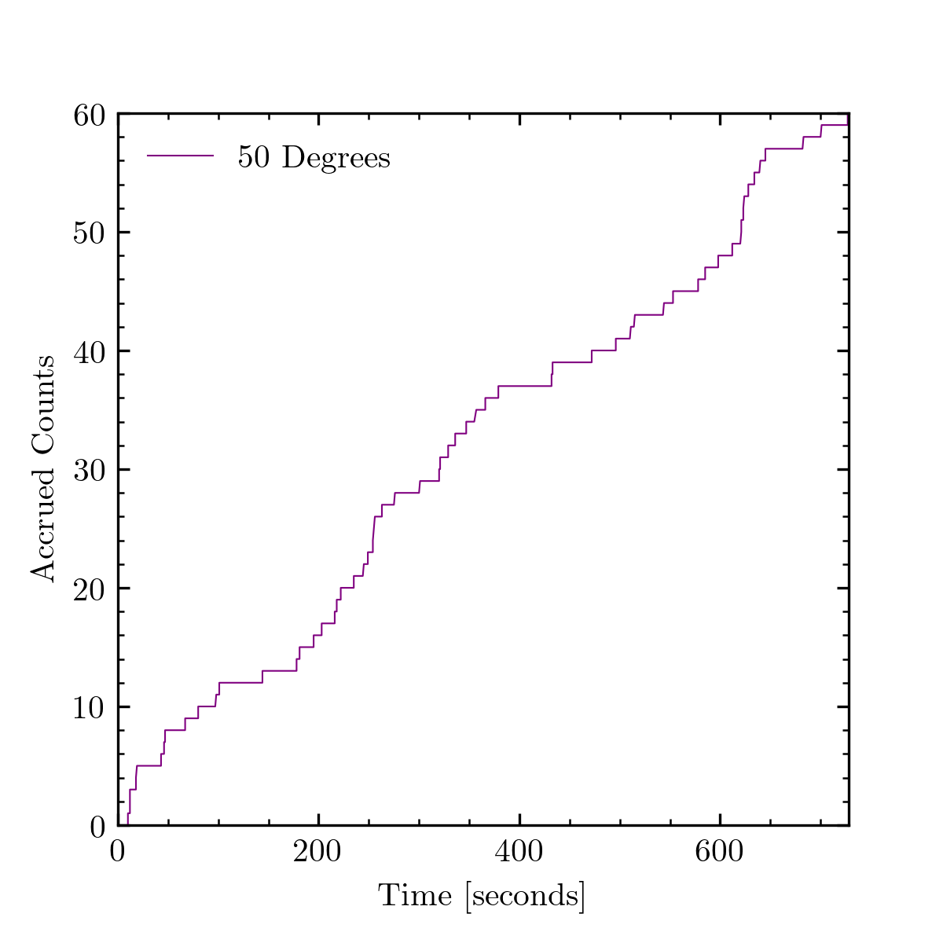
Raw Data: Accumulated Coincident Counts

Slide 9
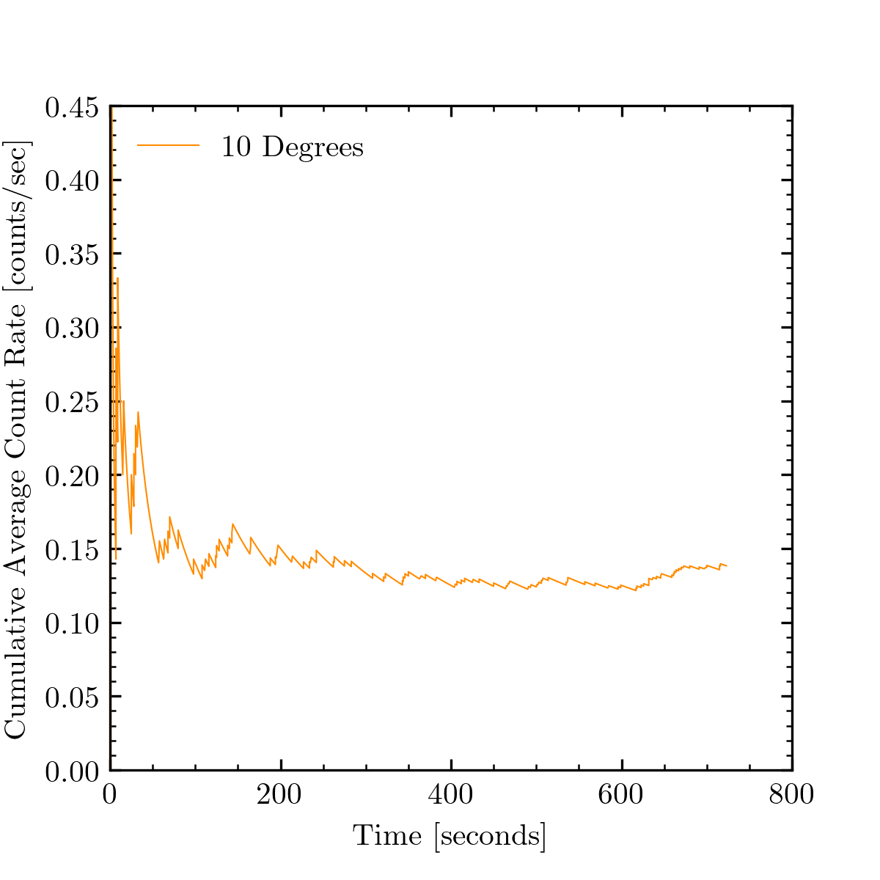
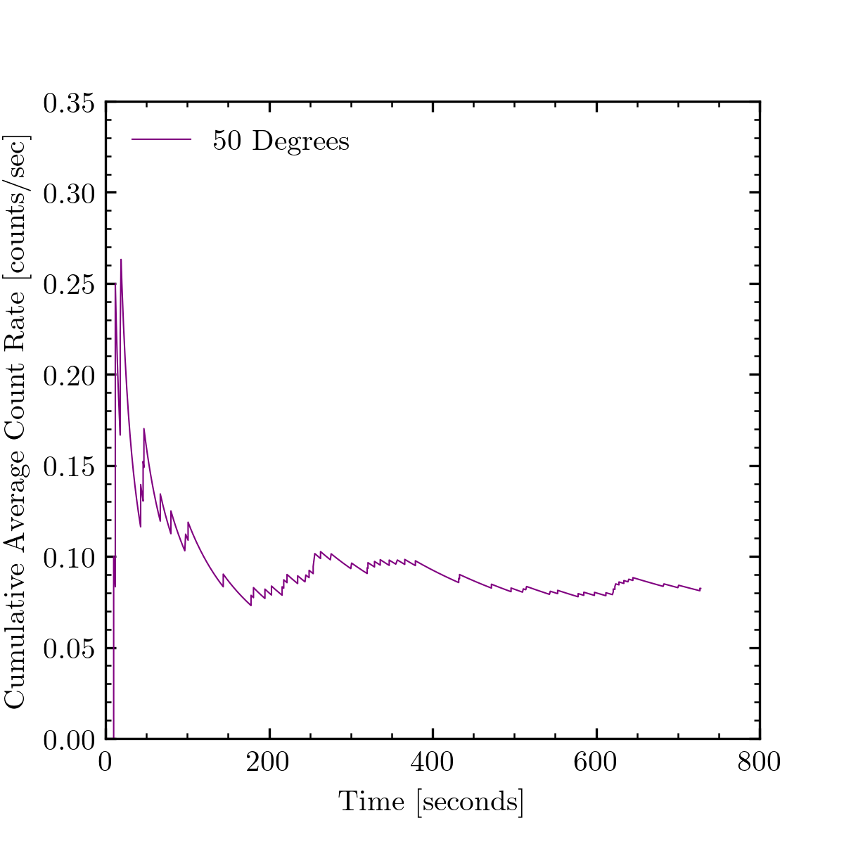
Raw Data: Cumulative Average Count Rate

Slide 10
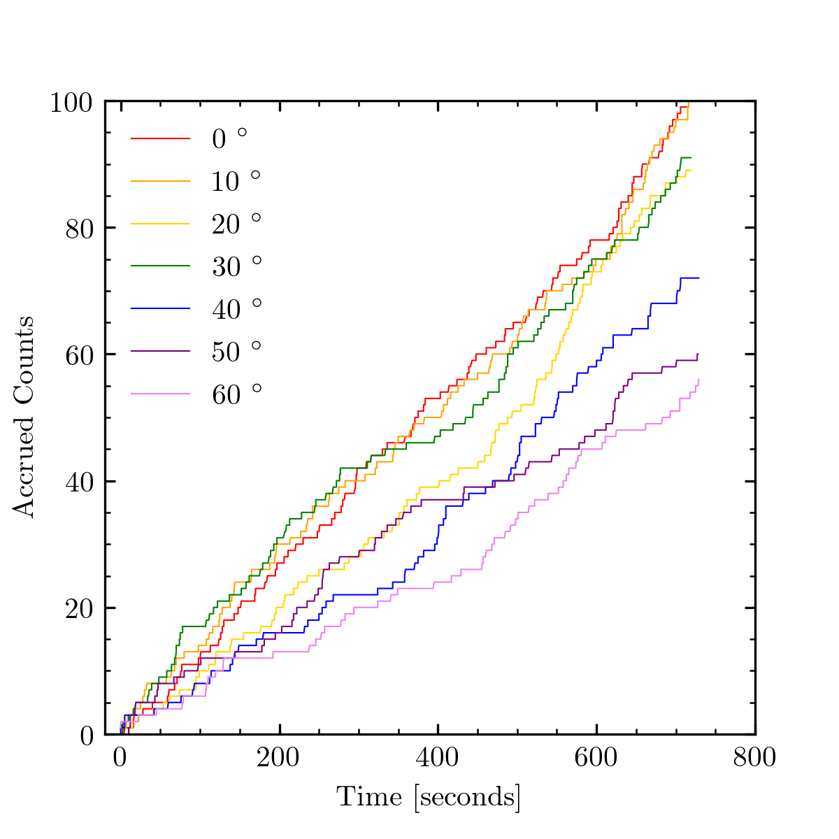
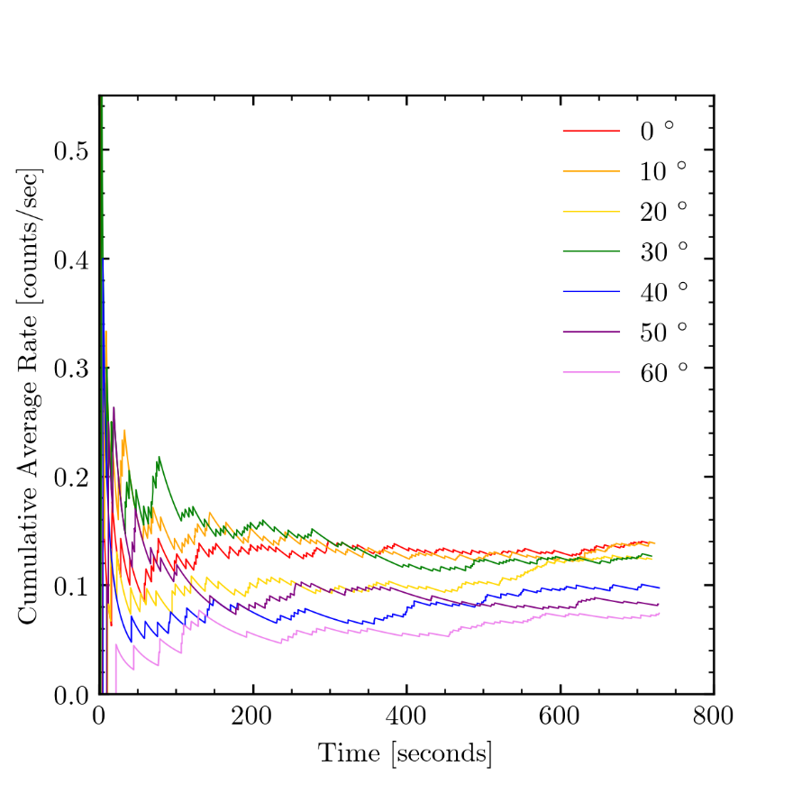
Cumulative Counts and Rate Visualized Together

Slide 11
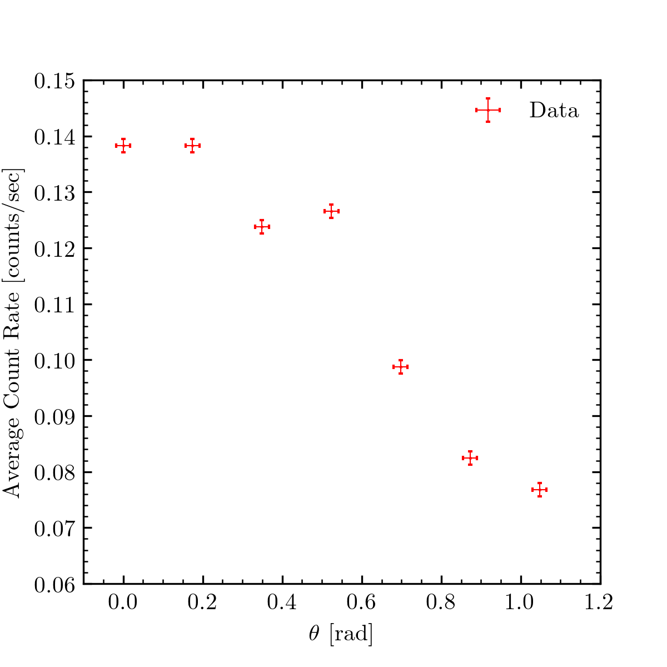
Observed Angular Dependence of Muon Rate

Slide 12
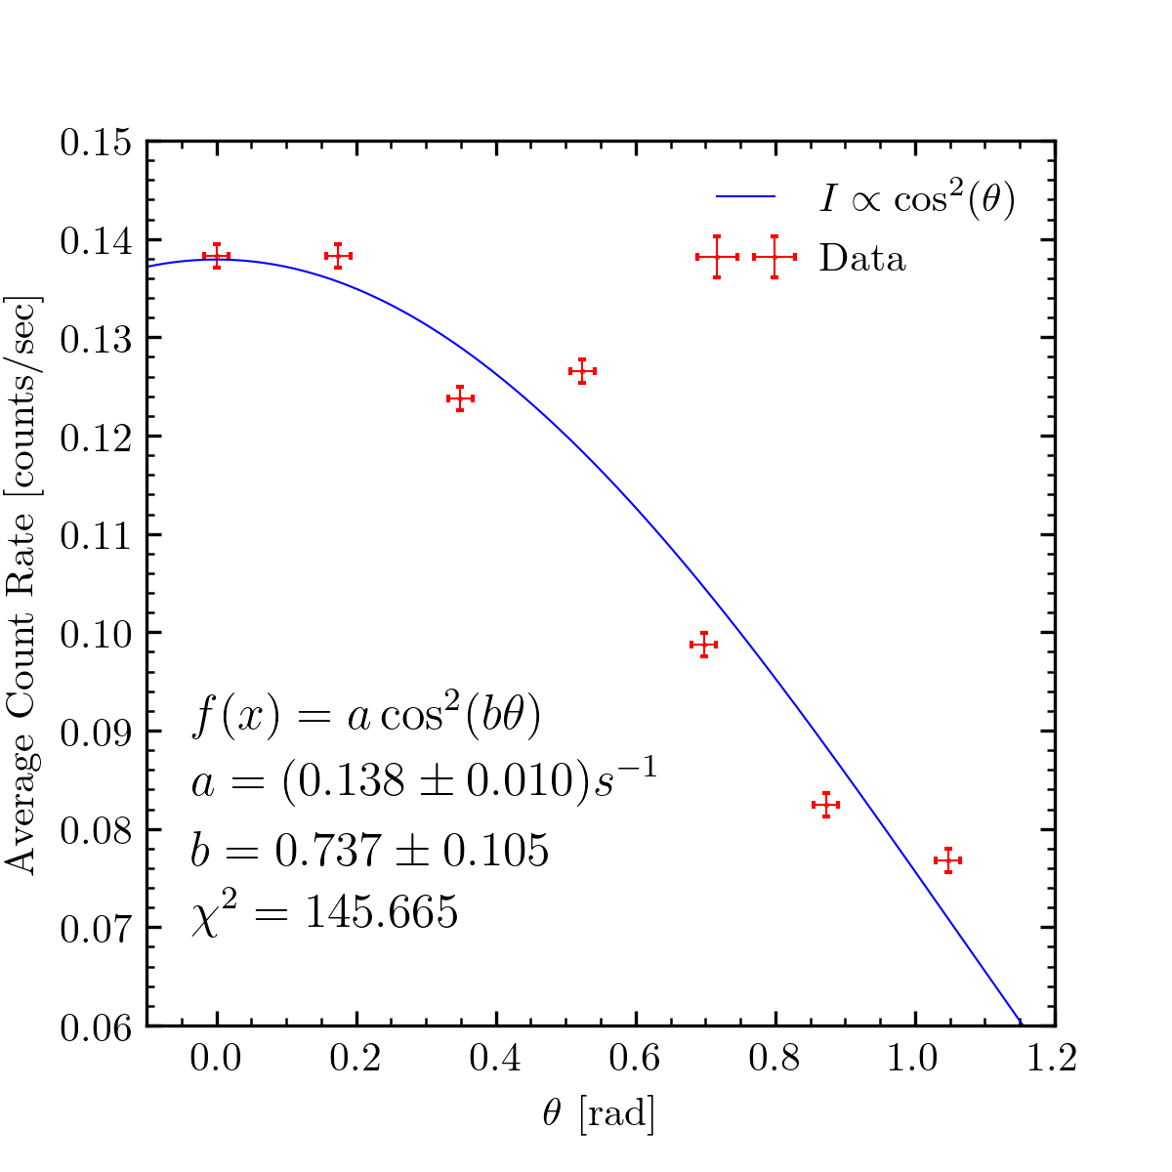
Fitting Muon Rate Data to Predicted Model

Slide 13
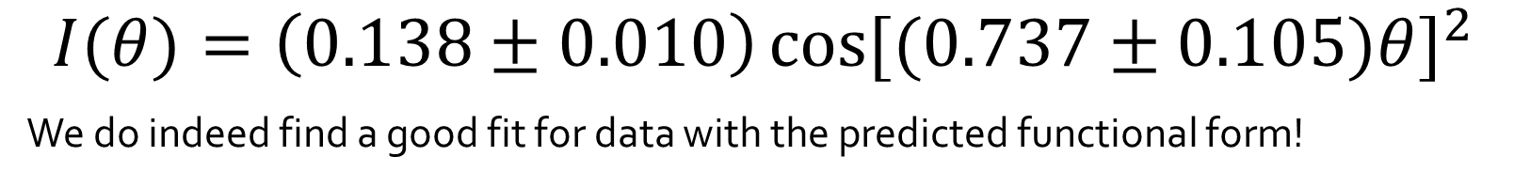
Results and Discussion of Errors
$$I(θ)=\left(0.138±0.010\right){\cos{[(0.737±0.105)θ]}}^{2}$$
We do indeed find a good fit for data with the predicted functional form!
Statistical
Systematic
Much fewer trials for each of the same angles → higher standard error on each measurement
Data gathering time per each angle only 12 minutes → greater statistical fluctuations throughout
Accidental coincidences recorded by the two detectors (small contribution)
Detectors placed on top of each other rather than side by side → larger subtended angle→ coincident muons not originating from small region of the sky (see appendix A)
Configuration of detectors may lead to higher muon detection rates than desired or realistic

Slide 14
Summary, Conclusions, and Future Goals
What did we accomplish?
We found a functional to describe our observed angular dependence of the muon rate
Compared our data to predicted models
What can be improved?
more trials at each angle
Longer data collection periods
Try different detector configurations for different solid angles
Where can these results lead?
Combine both angular dependence and shielding with materials with a study of altitude dependence
Functional form to incorporate angle and depth of muon detectors
Probing the standard model with muons:
Technique for separating signal from background at CMS → angular distribution as means to remove cosmic ray ‘background’ from proton-proton collision muons

Slide 15
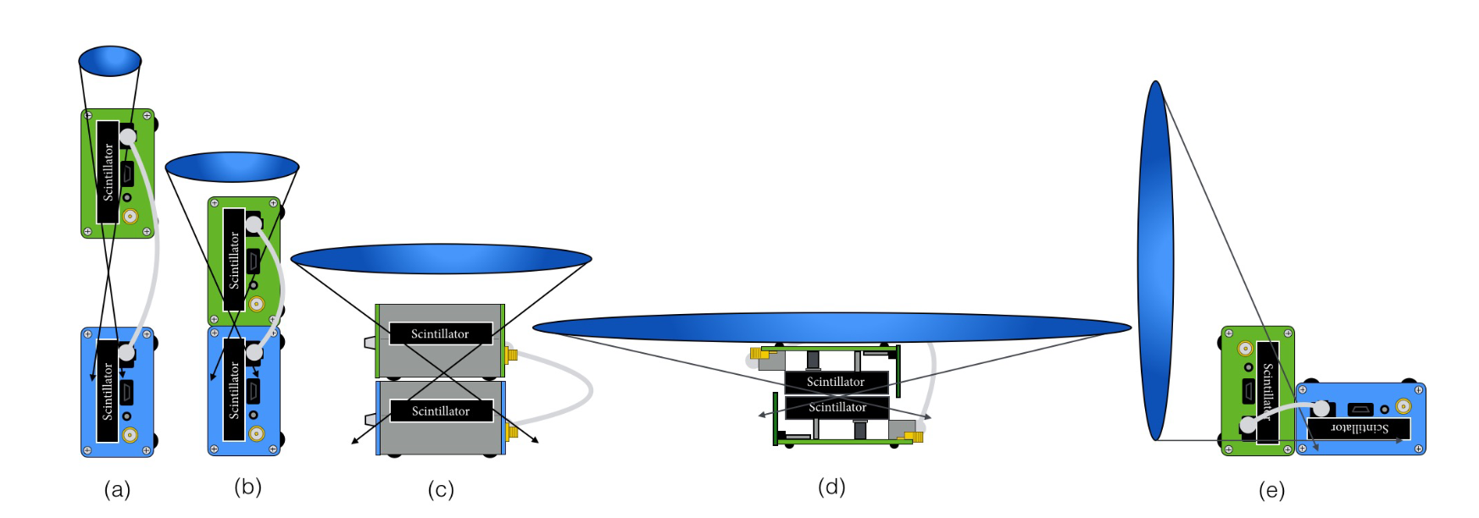
Appendix A: Subtended Solid Angle for Detector Configurations
Notes:
From left to right, subtended solid angle between detectors increases (represented by the blue ovals) as well as coincidence rate

Slide 16
